Slide 1

Windows CE System
4. Driver Development
School of software Engineering
2005

Slide 2
Agenda
Driver development overview
Stream Driver Interface
Device Driver Architecture
USB mouse driver sample
Windows CE Service

Slide 3
What is device driver
Device drivers communicate directly with devices. A device is a physical or logical entity that requires control, resource management, or both from the operating system (OS). A device driver is a software module that manages the operation of a virtual or physical device, a protocol, or a service. Device drivers are included in every Windows CE-based platform.
-- MSDN

Slide 4
“Common” Driver Develop understanding
Must use assembly language to read/write port
Device driver is a part of OS, difficult to write and debug.
Device drivers control hardware
Interrupt is somewhat hard to handle

Slide 5
Must use assembly language to read/write port
CEDDK.dll provides APIs to communicate with hardware.
  HalGetBusData
  READ_PORT_UCHAR
  WRITE_REGISTER_ULONG
For logical device driver, Win32 APIs are used to get data from hardware

Slide 6
Device driver is a part of OS, difficult to write and debug
For some OS like UNIX & Windows 9x, device driver is linked with OS image or run in kernel mode.
For windows CE, most of the device drivers run in user mode, simply a DLL file.

Slide 7
Device drivers control hardware
Most of the device drivers control hardware.
For some hardware, there are no drivers.
  CPU
  Memory
For virtual device driver, there are no physical devices.
  File system driver
  RAM disk

Slide 8
Interrupt is somewhat hard to handle
Windows CE offers logical interrupt (SYSINTRs)
Interrupt is just handled by a user mode thread (IST)

Slide 9
Why should write driver?
We design the hardware, so we must provide the driver.
Hardware OEMs do not provide the device driver on Windows CE. But they provide the hardware specification.
Extend the functionality of an existing driver.

Slide 10
Driver Category -- main
Windows CE separates device drivers into three main groups:
  Native
  Bus
  Stream interface

Slide 11
Native Driver
Also called built-in drivers, are those device drivers that are required for the hardware and were created by the OEM when the hardware was designed.
Ex: keyboard, touch panel, and audio.
Might not support the generic device driver interface. might extend the interface or have a totally custom interface to the operating system.
Native drivers frequently require minor changes when a new version of the operating system is released.

Slide 12
Bus Driver
Manage the system busses such as a PCI bus. PCMCIA and CompactFlash are also considered busses.
In charge of interrogating the hardware on the bus to determine what hardware is installed and allocating resources.
Also asks the Device Manager to load the proper drivers for the hardware on the bus.

Slide 13
Driver Category -- detail
Audio Drivers
Battery Drivers
Block Drivers
Bluetooth HCI Transport Driver
Direct3D Device Driver Interface
DirectDraw Display Drivers
Display Drivers
DVD-Video Renderer
IEEE 1394 Drivers
Keyboard Drivers
Notification LED Drivers
Parallel Port Drivers
PC Card Drivers
Printer Drivers
Serial Port Drivers
Smart Card Drivers
Stream Interface Drivers
Touch Screen Drivers
USB Drivers
See Document:
Driver Development -> Driver Categories

Slide 14
Driver Load Process
Most drivers are loaded by the Device Manager process (Device.exe) when the system boots.
Some of the built-in drivers, on the other hand, are loaded by GWES.exe. These drivers include the display driver (DDI.dll) as well as the keyboard and touch panel (or mouse) drivers.

Slide 15
Driver Load Process
When Device.exe loads, it looks in the registry under [HKEY_LOCAL_ MACHINE]\Drivers for a string value named RootKey, Traditionally, this key is named BuiltIn
The Device Manager then uses the registry enumerator to read the key specified by RootKey for the list of the drivers it must load when it initializes.

Slide 16
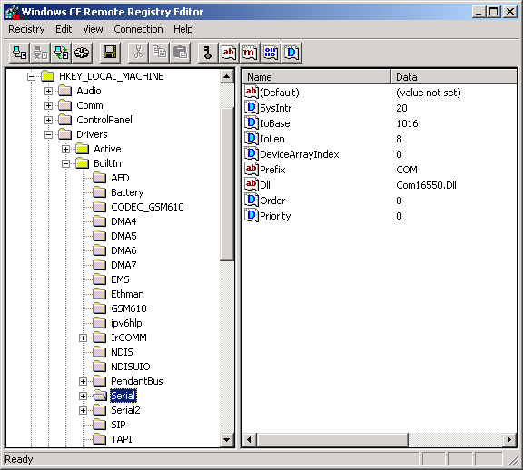
Driver Load Process

Slide 17
Driver Load Process
Load the DLL, creates an Active key for the driver and then calls either ActivateDevice or ActivateDeviceEx to register the DLL as a device driver with the system.
ActivateDevice creates a new key under [HKEY_LOCAL_MACHINE\Drivers\Active

Slide 18
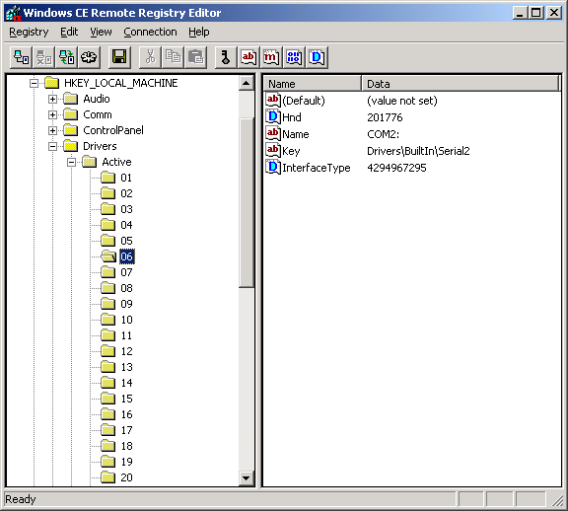
Driver Load Process

Slide 19
Driver Load APIs
Device drivers can also be loaded manually by applications. The preferred function is ActivateDeviceEx
An older method of loading a driver is RegisterDevice and DeregisterDevice

Slide 20
Agenda
Driver development overview
Stream Driver Interface
Device Driver Architecture
USB mouse driver sample
Windows CE Service

Slide 21
What is stream interface
A stream interface driver is any driver that exposes the stream interface functions, regardless of the type of device controlled by the driver.
Typical stream interface driver:
  File System driver (iostream, fstream)
  COM, LPT

Slide 22
Using stream interface
hSer = CreateFile(TEXT(“COM1:”), GENERIC_READ, 0, NULL, OPEN_EXSITING, 0, NULL);
rc = ReadFile(hSer, &ch, 1, &cBytes, NULL);
TransmitCommChar(hSer, ‘a’);
CloseHandle(hSer);
Use Win32 File System API directly.

Slide 23
Creating Stream Driver
Write a DLL that expose specific functions
Building the device driver
Configure the registry

Slide 24
Stream Interface functions
Function | Description
XXX_Close | Closes the device context identified by hOpenContext.
XXX_Deinit | Called by the Device Manager to de-initialize a device.
XXX_Init | Called by the Device Manager to initialize a device.
XXX_IOControl | Sends a command to a device.
XXX_Open | Opens a device for reading, writing, or both. An application indirectly invokes this function when it calls CreateFile to open special device file names.
XXX_PowerDown | Ends power to the device. It is useful only with devices that can be shut off under software control.
XXX_PowerUp | Restores power to a device.
XXX_Read | Reads data from the device identified by the open context.
XXX_Seek | Moves the data pointer in the device.
XXX_Write | Writes data to the device.

Slide 25
Build the device driver
Building a device driver is as simple as building a DLL.
Can use both Platform Builder and EVC++. All you need to do is create a Windows CE DLL project, export the proper entry points, and write the code.
The most frequently made mistake is in not declaring the entry points as extern C so that the C++ compiler doesn't mangle the exported function names.

Slide 26
Registry Setting
In Project.reg:
  [HKEY_LOCAL_MACHINE\Drivers\BuiltIn\Sample]
  "Dll" = "mydriver.Dll"
  "Prefix" = "DEM"
  "Index" = dword:1
  "Order" = dword:0
  "FriendlyName" = "Demo Driver"
  "Ioctl" = dword:0

Slide 27
Registry Setting
Order
  Set the relative load sequence for all drivers. All drivers with Order = 0 are loaded first, followed by drivers of Order = 1,2,… Within Order = 0, drivers are loaded as they appear in the registry. Order allows the developer to ensure drivers with dependencies to load in the proper sequence.
Index
  Specify the numeric portion of the driver name in the file system. By default, the first driver with a prefix of COM would be assigned file system name COM1 and the next driver would be given COM2. In order to ensure that your driver is always loaded as COM2 you would need to provide an Index = 2.

Slide 28

Demo :
Write a stream interface driver with emulator and use it

Slide 29
How does the driver work
When CE startup, Device.exe load all drivers according to registry setting.
When loading mydriver.dll DEM1_Init is called by device.exe.
Application call CreateFile(“DEM1”…)

Slide 30
How does the driver work (2)
Coredll.dll handles the API Call and switch to device.exe
Device.exe call DEM1_Open of mydriver.dll
CreateFile return the retval of DEM1_Open

Slide 31
Device Function Stack
Application
Device Manager(device.exe)
Device Driver
Windows CE DDK API
Hardware

Slide 32
Agenda
Driver development overview
Stream Driver Interface
Device Driver Architecture
USB mouse driver sample
Windows CE Service

Slide 33
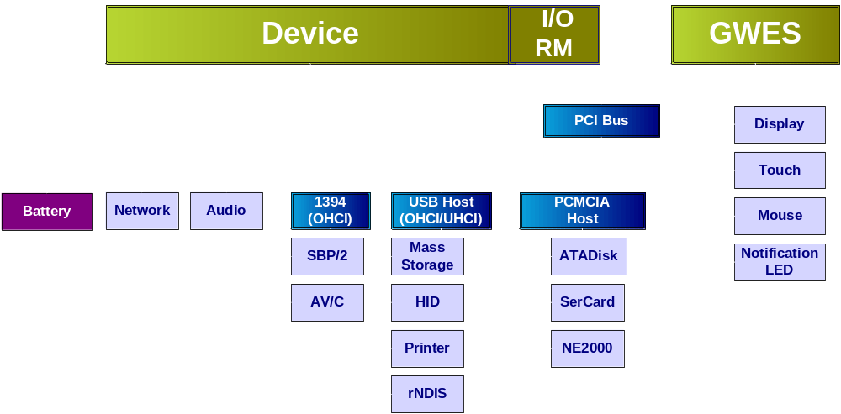
Driver Architecture

Slide 34
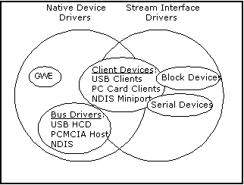
Types Of Drivers

Slide 35
Native Versus Stream Loading Mechanism
Generally Native device drivers are loaded in the GWES process space by
registry keys
Bus drivers loaded by Device.exe
using registry
Installable, Stream, and Hybrid drivers in Device.exe by either bus driver or
Registry Enumerator

Slide 36
Device Manager
User-level process that runs continously
Separate application that interacts with the kernel, the registry and stream interface driver DLLs
Provides ActivateDevice and DeactivateDevice APIs

Slide 37
Device Manager
Contains the IO Resource Manager
Loads the registry enumerator (RegEnum.dll) which in turn loads the drivers based on the registry
Provides power notification callbacks
  Tracks all loaded devices and issues device interface notifications for insertion
  and removal

Slide 38
Device Manager
Device Driver Loading Process
DEVICE.EXE
Kernel
loads
DEVICE.EXE
loads
I/O Resource Manager
(part of Device.exe)
I/O Resource Manager
(part of Device.exe)
REGENUM.DLL
REGENUM.DLL
loads
PCIBUS.DLL
PCIBUS.DLL

Slide 39
Registry Enumerator
Registry Enumerator is RegEnum.dll
Device.exe loads the Registry Enumerator from HKEY_LOCAL_MACHINE\Drivers\RootKey
Registry Enumerator scans the registry for more drivers to load
Registry Enumerator is re-entrant and supports hierarchical usage
When it gets unloaded, it also unloads anything it
directly loaded
Registry Enumerator examines the first level of keys just below the key passed to it, according to Order
Registry Enumerator invokes ActivateDeviceEx on each subkey it finds

Slide 40
ActivateDeviceEx
Exposed by Device.exe
Bus Drivers call ActivateDeviceEx when they load device drivers
ActivateDeviceEx also locks the stream interface driver into working RAM
This prevents code pages from being discarded
Registry Enumerator calls ActivateDeviceEx on each built-in
subkey it finds
ActivateDeviceEx loads driver and
updates registry

Slide 41
Interface Classes
Drivers are characterized by their interface
  Each IClass has a GUID and a Name
  GUID describes the generic device interface
  Name identifies the instance of an interface
    COM1:, DSK1: and so on
Exposing a driver’s interface
  IClass subkey in the registry
  Drivers publish interface – AdvertiseInterface
Apps query interface – RequestDeviceNotifications
Pre-defined GUIDs for existing interfaces
  A32942B7-920C-486b-B0E6-92A702A99B35

Slide 42
I/O Resource Manager
IORM is an intrinsic part of Device Manager
Tracks available I/O resources (IRQ and I/O base address)
OEM pre-allocates resources for built-in devices
Bus drivers request resources when loading a client driver on their bus
  ResourceRequest
  ResourceRelease
  ResourceCreateList
IORM fails ResourceRequest when there
is a conflict

Slide 43
Registry Helper Routines
Reads resource configuration from the registry
  OpenDeviceKey
  DDKReg_GetIsrInfo
  DDKReg_GetWindowInfo
  DDKReg_GetPciInfo
  APIs in COREDLL
  Prototyped in <devload.h> and <ddkreg.h>
Samples in public\common\oak\drivers
  wavedev\pdd\es1371\wavepdd.cpp -> GetRegistryConfig

Slide 44
Power Management
Power Manager
  Flexible infrastructure for system-level and peripheral-level power management
  Lets devices intelligently manage their
  own power
  Acts as a mediator between the devices and system/applications
  Enables OEMs to modify the code surrounding calls to PowerOffSystem()

Slide 45
Power Management
System-level power states
Device (peripheral) level power states
On | System Idle
User Idle | Suspend
D0 Fully Powered | D3 Sleep
D1 Low Performance | D4 Off
D2 Standby

Slide 46
Power Manager Architecture
Application
APIs
Application
Notification
Message Queue
PM APIs
Power Manager (pm.dll)
Drivers
Driver
APIs

Slide 47
Physical Memory
Kernel Virtual Address
Physical Memory
Reserved
C0000000
Dbg Serial Port
512 MB
Uncached
82000000
32 MB Flash
32 MB
Flash
80000000
64 MB RAM
04000000
A0000000
64 MB
RAM
512 MB
Cached
32 MB Flash
64 MB RAM
80000000
0
2 GB
User

Slide 48
Virtual Address Space
4 GB
Not Used
Accessable via MmMapiIoSpace
3 GB
512M Non-Cached
Above 2G-3G
Mapped to physical memory
0xA0000000
512M Cached
Virtual address space
2 GB
0x80000000
Memory mapped files
Slot 32
Slot 32
64 MB
Slot 1
32 MB
Slot 0
64 KB
NULL pointers

Slide 49
Memory Management Functions
Device drivers are user-mode modules
  Necessary to map physical memory to
  virtual memory
VirtualAlloc, VirtualFree: reserve, free virtual memory
  MEM_RESERVE
VirtualCopy: Maps a physical memory range to a virtual memory range
  PAGE_NOCACHE
  PAGE_PHYSICAL

Slide 50
Driver Memory Access – Mapped
MapPtrToProcess
  Allows you to map a pointer from one address space to another
GetCurrentProcess / SetProcPermissions
  Retrieves a process identifier to be used with the MapPtrToProcess function
MmMapIoSpace
  maps a physical address space to a nonpaged, process-dependent address space.

Slide 51
CEDDK
CE v2.1x and later supports a platform independent I/O scheme
Left up to the OEM and driver writer to actually use them
CEDDK.DLL
  BUS Management
  Memory Management
  I/O Management
CEDDK APIs taken from NTDDK
  Not documented until V2.12
  But most available in V2.00

Slide 52
CEDDK Abstraction
Device Manager
Device drivers use CEDDK
Properly written drivers are binary compatible across platforms
  Source code compatible across CPUs
Device Driver
CEDDK.DLL
Hardware

Slide 53
CEDDK Internals
Coverage | Function Examples
Bus Management | HalGetBusDataByOffset() HalGetBusData() HalSetBusDataByOffset() HalSetBusData() HalTranslateBusAddress() HalTranslateSystemAddress()
Memory Management | MmMapIOSpace – MmUnmapIOSpace HalAllocateCommonBuffer
I/O Access XXXX => UCHAR/USHORT/ULONG | READ_REGISTER_XXXX WRITE_REGISTER_XXXX READ_PORT_XXXX WRITE_PORT_XXXX

Slide 54
Interrupt Architecture
Interrupt is just a particular exception
  Caught by kernel code
  Dealt with prior to resuming user code
  But hardware is independent of OS
CE uses two stage Interrupt Service model
  Lightweight code to quiet interrupt
  Scheduled code to service hardware
OS provides API for enabling IRQ signals, prioritization, etc.
Hardware specific operations done in OAL and device driver code

Slide 55
Notes On ISRs And ISTs
ISTs are plain old user mode code
  Full CE .NET API and CRT library available
  CE .NET scheduler controls IST execution based on thread priority
  Run-time binding to SYSINTR
ISRs are called from Exception Handler
  No OS services available
  Stack space is limited
  May be reentrant (OAL choice)
  Assembly language on MIPS, SHx

Slide 56
ISR Observations
IRQ priorities CPU architecture dependent
  PIC hardware handles this on x86
  OAL arrays IntrPriority, IntrMask on MIPS
OAL could add real-time feature allowing IST processing to preempt ISR service
Under CE 3.0, all ISR code part of OAL
  Not particularly expandable
  IRQs bound to event IDs in OEMInit
  No Support for PNP, IRQ sharing (PCI bus)
CE .NET addresses these limitations with Installable ISR (IISR) chain

Slide 57
CE .NET Installable ISRs
Preferable Extension to CE 3.0 ISR architecture
DLL code, bound at run time
Source code can be CPU independent
  Typically coded in “C”
  Some restrictions apply
    No calls to CRT, Windows API, or other DLLs
Run-to-completion ISR, or IST dispatch
Support for hardware IRQ sharing
  Distinct SYSINTR ID from same IRQ

Slide 58

CE .NET Interrupt Handling
Driver
IST
SYSINTR_CHAIN
IISR
IISR₁
IISR₂
IISR_{n}
Kernel
Except.
Handler
SYSINTR_xx
SYSINTR_NOP
Set
Event
PSR
SYSINTR_ID
OAL
NKCallIntChain(IRQ)
ISR
HW
None
Higher Priority IRQs Enabled
IRQ Masked

Slide 59
Interrupt Service Thread
Is user-mode thread of device drivers for
built-in devices
Does the actual processing of the interrupt
Creates an event object associated with the logical interrupt by calling CreateEvent function
IST remains idle most of the time, awakened when the kernel signals the event object
IST usually runs at above-normal priority, boost priority with CeSetThreadPriority function

Slide 60
Interrupt Service Thread
InterruptInitialize
  Call InterruptInitialize to link the Event with the Interrupt ID of the ISR
WaitForSingleObject
  Can be used to wait for an event to be signaled
  This call is usually inside a loop so that when interrupt is processed, the IST gets back to this call waiting for the next interrupt to be handled
InterruptDone
  After the interrupt data is processed, the IST must call the InterruptDone function to instruct the kernel to enable the hardware interrupt related to this thread

Slide 61
Typical IST Start
struct ISTData // Declare the Strucure to pass to the IST
{
HANDLE hThread; // IST Handle
DWORD sysIntr; // Logical ID
HANDLE hEvent; // handle to the event to wait for interrupt
volatile BOOL abort; // flag to test to exit the IST
};
ISTData g_KeypadISTData;
// Create event to link to IST
g_KeypadISTData.hEvent = CreateEvent(NULL, FALSE, FALSE, NULL);
// Translate IRQ to an logical ID (x86 CEPC)
g_KeypadISTData.sysIntr =Mapirq2Sysintr(5);
// start the thread
g_KeypadISTData.hThread = CreateThread(NULL,0,&KeypadIST,
&g_KeypadISTData, 0, NULL);

Slide 62
Typical IST Start
//Change the threads priority
CeSetThreadPriority(g_KeypadISTData.hThread,0);
//disconnect any previous event from logical ID
InterruptDisable(g_KeypadISTData.sysIntr);
// Connect Logical ID with Event
InterruptInitialize(g_KeypadISTData.sysIntr, g_KeypadISTData.
hEvent,NULL,0);
Set the IST Thread Priority
Disconnect any previous events from the associated ISR
Connect to the associated ISR

Slide 63
Typical IST Start
DWORD KeypadIST(void *dat)
{
ISTData* pData= (ISTData*)dat;
// loop until told to stop
While(!pData->abort)
{ // wait for the interrupt event...
WaitForSingleObject(pData->hEvent, INFINITE)
if(pData->abort)
break;
// Handle the interrupt...
// Let OS know the interrupt processing is done
InterruptDone(pData->sysIntr);
}
Return 0;
}

Slide 64
Typical IST Stop
// set abort flag to true to let thread know
// that it should exit
g_KeypadISTData.abort =TRUE;
//disconnect event from logical ID
//this internally sets g_KeypadISTData.sysIntr which in turn
//sets g_KeypadISTData.hEvent through the kernel
InterruptDisable(g_KeypadISTData.sysIntr);
//wait for thread to exit
WaitForSingleObject(g_KeypadISTData.hEvent,INFINITE);
CloseHandle(g_KeypadISTData.hEvent);
CloseHandle(g_KeypadISTData.hThread);
Set a flag that will cancel the IST loop
Call InterruptDisable to disconnect the triggering event from
the logical ID
Close the Thread Add Reference for the code

Slide 65
Bus Drivers Overview
PCMCIA
  I82365 (ISA)
  TI-1250 (PCI)
USB Host
  Multiple Host Controllers
    OHCI and UHCI (PCI)

Slide 66
PCMCIA Host
PCMCIA bus driver has three main threads
  Status change thread (card insertion/removal)
  Interrupt thread (handles card functional interrupt requests)
  Callback thread (notifies card clients of events)
Bus driver supports a subset of Card Serv. messages, delivered as callbacks from the callback thread
Interrupts are delivered to client drivers as callbacks
Newly inserted cards are scanned for identifying PnP tuples and compared with entries in the registry
If no match is found, candidate drivers can run “detect” routines to card-specific mechanisms to ID the card
  May display a dialog box asking for the name of the DLL

Slide 67
USB Host
USB Version 1.1 compliant
OHCI and UHCI fully supported
Support for all transfer types
  Isoch, bulk, interrupt, control
USBD supports multiplexing between multiple HC
Client drivers are typically loaded using LoadDriver and use USBD operations to communicate with the HC
Client drivers can optionally call ActivateDeviceEx() on themselves to expose a stream interface to apps
Detects and identifies newly attached devices
Loads drivers as described in the registry
  May display a dialog box asking for the name of the DLL

Slide 68
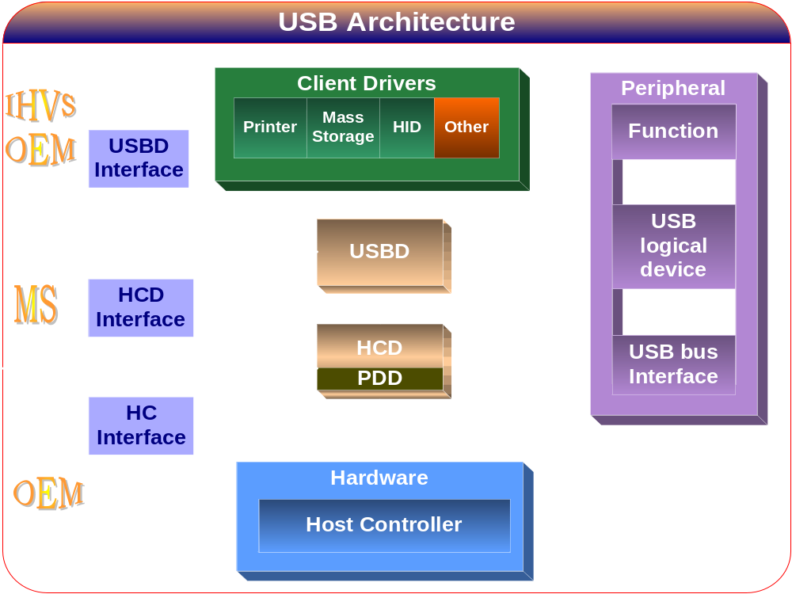

Slide 69
Programming Model
USB Client
Driver
GWE subsystem
Device
Manager
USBD
DDI
Monolithic
Driver
(display)
MDD
MDD
MDD
DDSI
DDSI
HCD
PDD
PDD
PDD
OEM Hardware

Slide 70
Agenda
Driver development overview
Stream Driver Interface
Device Driver Architecture
USB mouse driver sample
Windows CE Service

Slide 71
USB Driver Transfer type
Control transfers
  USB printer, USB digital camera
Isochronous transfers
  USB internet phone
Interrupt transfers
  Mouse, keyboard, game controller
Bulk transfers
  USB camera

Slide 72
Required Entry Points
USBDeviceAttach
  The USB driver module calls this function when a device is attached
USBInstallDriver
  The USB driver module calls this function when an unrecognized device is attached to the USB
USBUnInstallDriver
  A client driver can call this function to deregister from a USB driver.

Slide 73
USB Mouse Model
Application
USB Mouse Driver
usbd.dll
Hardware

Slide 74
Demo:
USB Mouse Driver Code

Slide 75
Agenda
Driver development overview
Stream Driver Interface
Device Driver Architecture
USB mouse driver sample
Windows CE Service

Slide 76
Service concept & history
Before Windows CE 4.0, no service available
So called “Device driver” is written as a workaround
After Windows CE 4.0, Services Manager is introduced

Slide 77
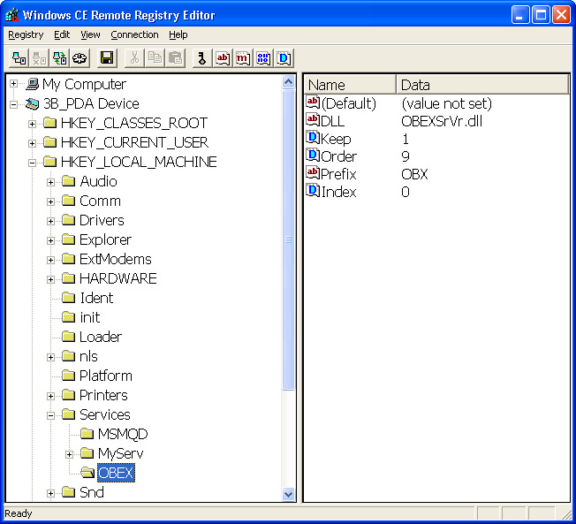
Services registry

Slide 78
Service Architecture
A CE service is a DLL that is constructed almost identically to a stream device driver
Like a stream driver, a Windows CE service exports the same 10 entry points, from xxx_Init to xxx_PowerDown
Service has three chars prefix

Slide 79
The Service IOCTL Commands
IOCTL_SERVICE_START
IOCTL_SERVICE_STOP
IOCTL_SERVICE_REFRESH
IOCTL_SERVICE_INSTALL
IOCTL_SERVICE_STATUS
IOCTL_SERVICE_SUPPORTED_OPTIONS

Slide 80
Application Control of a Service
ActivateService
RegisterService
GetServiceHandle
ServiceIoControl
DeregisterService

Slide 81
Homework
Read online help on Service.exe and implement your own service on Windows CE.
Application sends I/O control command, then service routine log the current time to a file.

